Slide 1
Pick up miss error HD348 HX8000

Slide 2
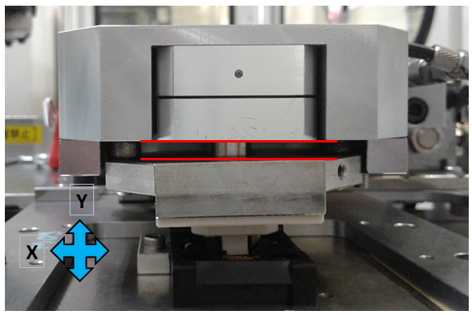
Problem: Misaligned Clamper at x-axis position, causing work press to slide from left to right during contact.
Possible cause: 1. Can damage socket and device leads.

Slide 3
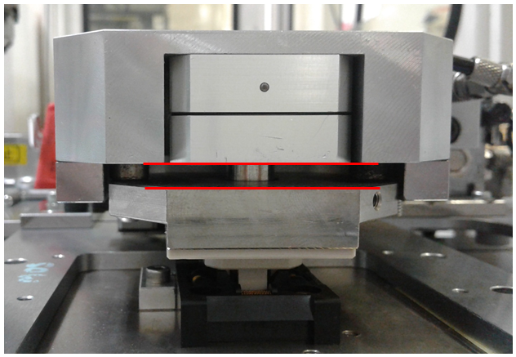
Corrective Actions:
Adjustment of clamper position with respect to socket.
Visual inspection 10 trays, no issue related to lead defects.

Slide 4
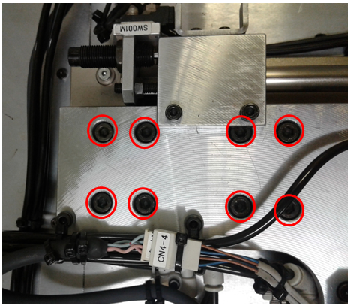
How to adjust:
Loosen the 8pc bolts that holds Clamper assembly.
Manually re-aligned clamper to socket respectively.
Tightened bolts with sequence from the center going to the outer at X sequence to get perfect flatness.
The benefit of this will prolonged the lifespan of our sockets and prevent any possibilities of lead defects.
This can also include in checklist activity during setup conversion and machine qualification.

Slide 5
Thank you!

